Slide 1

PROBLEM SOLVING USING PROGRAMMING (JAVA)
Restaurant Order, Kitchen and Billing System
ACADEMIC YEAR: 2026-2027
COURSE INSTRUCTOR: Mr. G. Balaiah
TEAM 15
Presented by:
S. Tejaswi - 2620030364
P. Geethika - 2620030370
Akula Akshara - 2620030502

Slide 2
Restaurant Order, Kitchen and Billing System
OBJECTIVES
  To simplify food ordering and billing.
  To calculate bills accurately.
  To manage order and kitchen status.
  To demonstrate Java programming concepts through a practical application.
Abstract & Objectives
The Restaurant Order, Kitchen and Billing System is a menu-driven Java application developed to simplify basic restaurant operations. It allows users to view food items, place orders, manage kitchen status, generate bills, and save billing records. The system uses Java programming concepts to improve accuracy and reduce manual effort.

Slide 3
Restaurant Order, Kitchen and Billing System
Understanding the Problem Statement
Problem Statement:
Managing restaurant orders, kitchen operations and billing manually can be time-consuming and may lead to calculation errors.
Need for the System:
  To simplify the food ordering process.
  To manage customer orders efficiently.
  To calculate bills accurately.
  To maintain a record of daily sales.
Proposed Solution:
A menu-driven Java application that manages food orders, kitchen operations and billing through a simple console interface.

Slide 4
Restaurant Order, Kitchen and Billing System
Technologies and Concepts Used
Java Concepts Implemented:
  Variables and Data Types: Store prices, quantities and order details.
  Conditional Statements: Handle menu choices and user options.
  Loops: Repeat menu operations.
  Arrays: Store and manage food items and their details.
  Methods: Organize the program into smaller tasks.
  Classes and Objects: Structure the restaurant system.
  Scanner Class: Accept input from the user.
Programming Language: Java
Code Editor:
Visual Studio Code (VS Code)

Slide 5
Restaurant Order, Kitchen and Billing System
Modules & Features
  Menu Management – Displays food items and their prices.
  Order Management – Allows customers to place orders.
  Order Tracking – Displays the details of placed orders.
  Kitchen Management – Manages order preparation status.
  Billing System – Calculates the bill amount, including applicable charges.
  Food Item Search – Helps find specific food items.
  Sorting and Sales Summary – Organizes food items and displays sales information.
  File Handling – Stores restaurant records for future reference.

Slide 6
Restaurant Order, Kitchen and Billing System
CO1 - Variables, Data Types and Operators
Concept Used:
Variables store data, data types define the kind of information stored, and operators perform calculations.
Implementation in Our Project:
  Variables store food prices, quantities and order details.
  int stores quantities.
  double stores prices and bill amounts.
  Arithmetic operators calculate the cost of food items.
Example:
double total = price * quantity;
Outcome:
These concepts help calculate order costs and manage restaurant information.

Slide 7
Restaurant Order, Kitchen and Billing System
CO2 - Control Flow: Selection & Iteration
Concepts Used: Conditional Statements, Loops, switch-case and Iteration
Implementation in Our Project:
  Conditional statements check user choices and other conditions.
  switch-case can handle different menu options.
  Loops repeat operations such as displaying menu items and processing orders.
  Exit conditions control when repetition stops.
Example:
switch (choice) {
case 1: // Place an order
break;
}
Outcome:
Control flow helps the program make decisions and repeat operations efficiently.

Slide 8
Restaurant Order, Kitchen and Billing System
CO3 — Decomposition with Methods, Recursion & Arrays
Concepts Used: Methods and Arrays
Implementation in Our Project:
  Methods divide the program into smaller, manageable operations.
  Arrays store related information such as food items and prices.
  Loops can process multiple elements in an array.
  Methods make the code easier to read, test and maintain.
Example:
double[] prices = {100.0, 150.0, 200.0};
Outcome:
Methods and arrays help organize restaurant operations and manage multiple food items efficiently.

Slide 9
Restaurant Order, Kitchen and Billing System
CO4 — Object-Oriented Modelling, Design & Exception Handling
Concepts Used: Classes, Objects, Encapsulation and Exception Handling
Implementation in Our Project:
  Classes can represent restaurant entities such as food items or orders.
  Objects represent individual instances of a class.
  Encapsulation groups data and related methods together.
  Exception handling can manage invalid input or runtime errors.
Example:
class FoodItem {
String name;
double price;
}
Outcome:
Object-oriented programming helps structure a program, while exception handling improves its reliability.

Slide 10
Restaurant Order, Kitchen and Billing System
CO5 — Strings, Library Algorithms & File I/O
Concepts Used: String Methods, Searching, Sorting and File Handling
Implementation in Our Project:
  Strings represent food names and other text details.
  String methods can process or compare text.
  Searching and sorting algorithms can organize food items.
  File I/O can store and retrieve restaurant records.
Example:
String item = "Veg Burger";
System.out.println(item.toUpperCase());
Outcome:
String operations and library algorithms help process information, while file handling enables persistent storage.

Slide 11
Restaurant Order, Kitchen and Billing System
CO6 — Functional Programming with Collections & Streams
Concepts Used: Collections, Generics, Lambdas and Stream Pipelines
Implementation in Our Project:
  Collections can store and manage groups of restaurant orders.
  Generics provide type-safe data structures.
  Lambda expressions can simplify operations on data.
  Streams can filter, sort and process collections of items.
Example:
List<String> items = new ArrayList<>();
items.add("Veg Burger");
Outcome:
Collections and functional programming APIs support flexible and efficient data management.

Slide 12
Restaurant Order, Kitchen and Billing System
Conclusion
  Developed a menu-driven Java application for restaurant order management, kitchen operations and billing.
  Applied Java programming concepts such as variables, control statements, loops and methods.
  Simplified order processing and bill calculation through a structured program.
  Gained practical experience in problem-solving, program development and debugging.
Future Scope:
The system can be enhanced with a graphical user interface, database integration and digital payment support.

Slide 13
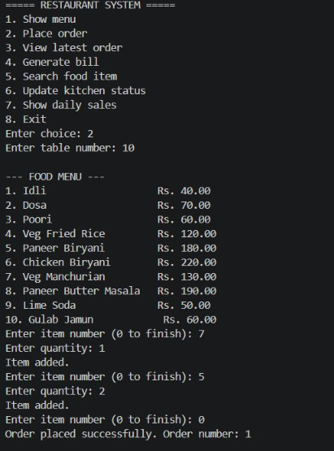
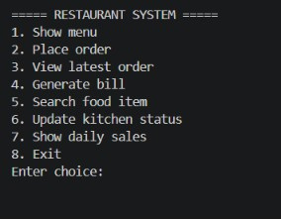
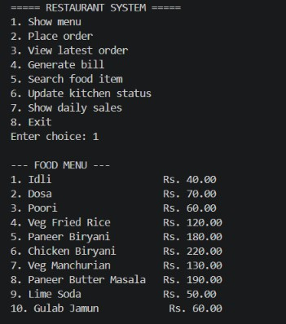
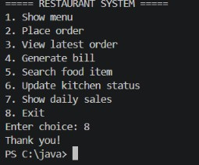
Restaurant Order, Kitchen and Billing System
Main menu
shows the food menu when option 1 is chosen
to place order choose the option ‘2’
Exits when choice 8 is entered

Slide 14
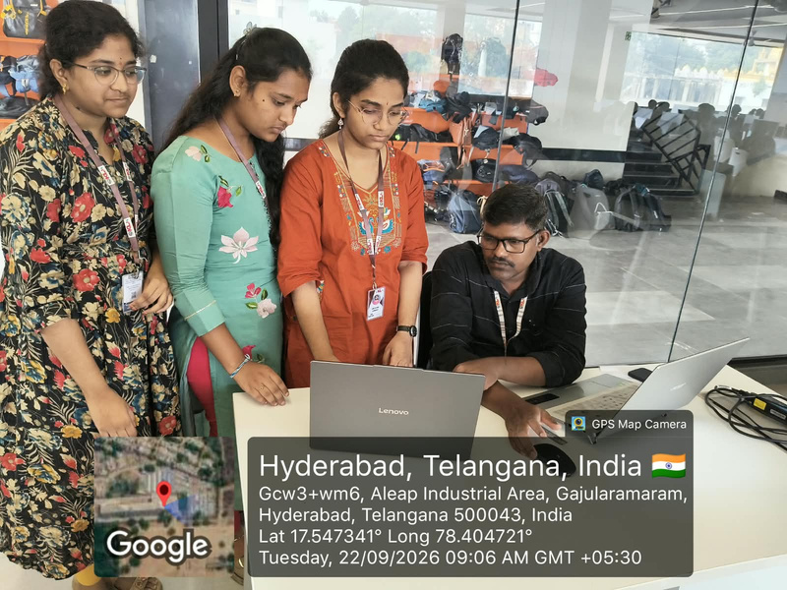
Restaurant Order, Kitchen and Billing System
Geotag photo
Github Link:
https://github.com/AkulaAkshara/KLH_CSE_PSPJAVA_T15_ROKB

Slide 15
Restaurant Order, Kitchen and Billing System
Thank You

